Slide 1

Documentation Essentials
With focus on in-line documentation

Slide 2
WHY…?

Slide 3

Why document code…?
Code lives longer than you think…
Code changes hands more often than you think…
Your memory is poorer than you think…

Slide 4

Why document code…?
External pressure: laws, standards, etc..
Day 1 collaboration made easier
Teases out requirement clarification: if you cannot describe what a function is supposed to do -> red flag.
Teases out code clarity: why is the code not self-explanatory…?

Slide 5

Forms of documentation
High-level: diagrams, architecture descriptions, etc..
NB: A process artifact like a diagram can play two roles:
Means of communication during development
Documentation after development
Be aware of the role of your artifacts!
This presentation will not focus on high-level documentation…

Slide 6
Forms of documentation
Low-level: documentation directly integrated with code
Usually in the form of comments, which are “in-lined” with code
Classic comments in C#/.NET code:
// This is a traditional comment
int a = 12;
/* This is also a traditional comment,
but on multi-line form */
int b = 13;

Slide 7
Forms of documentation
A newer form of comments is the XML documentation comment
Starts with three ///:
Usually surrounded with an XML tag
Can be used to generate documentation artefacts!
/// <summary>
/// This is an XML documentation comment
/// </summary>
public class SimpleRepositoryInMemory<T> : ISimpleRepository<T>
{

Slide 8
Targets for commenting
Classic comments
Used for documenting actual implementation.
Target audience is a maintainer of implementation.
public class SimpleRepositoryInMemory<T> : ISimpleRepository<T>
{
// Objects are stored in-memory in a List object.
private List<T> _list = new List<T>();
…
}

Slide 9
Targets for commenting
XML documentation comments
Used for documenting interfaces (in a broad sense)
Actual interfaces/classes at top level
Methods/properties in interfaces
Target audience is a client of a class/interface.
/// <summary>
/// Interface for a service which manages a collection of objects of type T
/// </summary>
/// <typeparam name="T">Type of objects managed by the service</typeparam>
public interface ISimpleRepository<T>
{

Slide 10
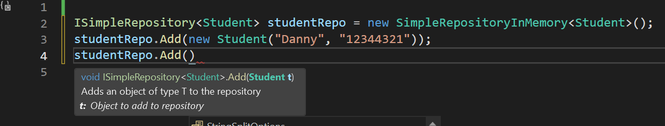
Why not use XML-doc comments everywhere…?
Intended to document interfaces, not implementation (an intention, not a rule…)
XML-doc comments provide benefits in Visual Studio IDE, in the form of Intellisense pop-up boxes

Slide 11
/// <summary>
/// Interface for a service which can manage a collection of objects of type T
/// </summary>
/// <typeparam name="T">Type of objects managed by the service</typeparam>
public interface ISimpleRepository<T>
{
/// <summary>
/// Adds an object of type T to the repository
/// </summary>
/// <param name="t">Object to add to repository</param>
public void Add(T t);
/// <summary>
/// Retrieves a read-only list containing all objects which have been added to the repository.
/// </summary>
/// <returns>All objects which have been added to the repository</returns>
public IReadOnlyList<T> GetAll();
}

Slide 12
/// <summary>
/// Interface for a service which can manage a collection of objects of type T
/// </summary>
/// <typeparam name="T">Type of objects managed by the service</typeparam>
public interface ISimpleRepository<T>
{
/// <summary>
/// Adds an object of type T to the repository
/// </summary>
/// <param name="t">Object to add to repository</param>
public void Add(T t);
/// <summary>
/// Retrieves a read-only list containing all objects which have been added to the repository.
/// </summary>
/// <returns>All objects which have been added to the repository</returns>
public IReadOnlyList<T> GetAll();
}

Slide 13
Available tags for xml-doc comments
Quite a lot… (https://learn.microsoft.com/en-us/dotnet/csharp/language-reference/xmldoc/recommended-tags)
Most common are
<summary> (for interfaces/classes/methods/properties)
<returns> (return value for methods)
<param> (parameters for methods)
<typeparam> (type parameters for interfaces/classes/methods)
<inheritdoc> (reuse e.g. interface documentation on classes implementing the interface)

Slide 14

MUST I DOCUMENT EVERYTHING, MASTER…!?

Slide 15
Focused documentation
A minimum could be
<summary> for all interfaces/base classes
<summary> for all non-trivial (?) properties in interfaces/base classes
<summary> for all non-trivial (?) methods (including constructors) in interfaces/base classes
Documentation is a bit like test
Ideally 100 %, in practice less so…
Use effort where it adds most value

Slide 16
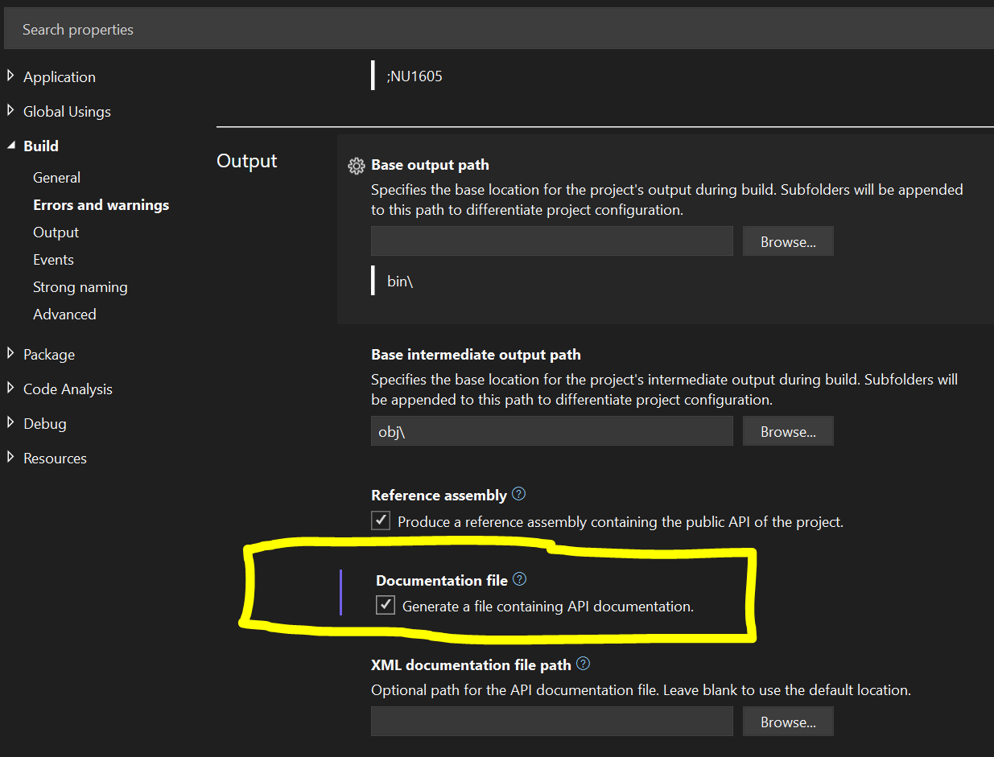
Generating documentation artefacts
Visual Studio can generate an XML file from XML-doc comments
Right-click on project, choose Properties | Build | Output
Tick off Generate a file containing API documentation
Optional: fill in path for where to place generated file

Slide 17
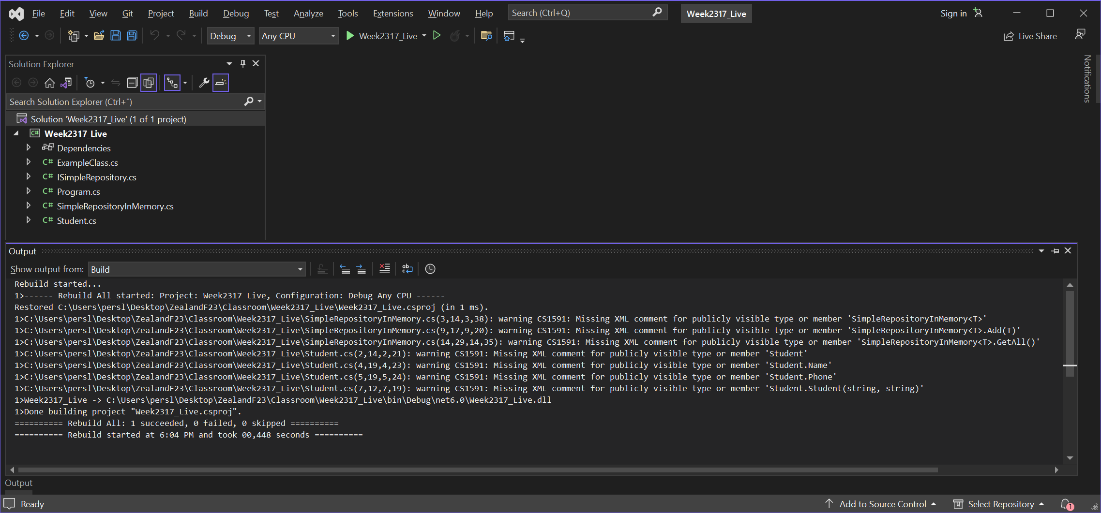


Slide 18
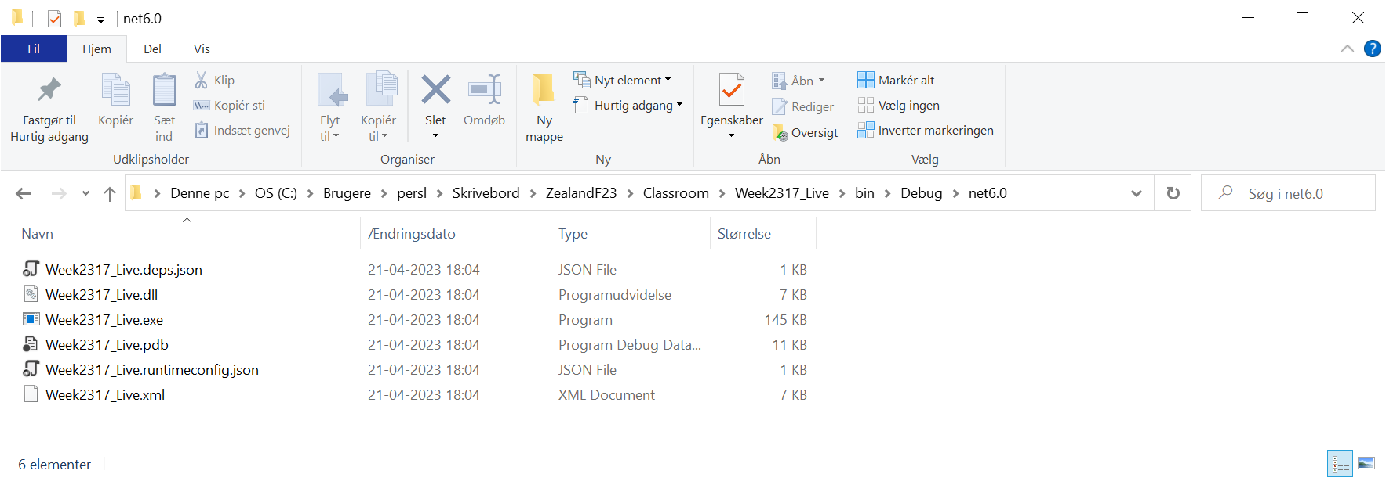

Slide 19
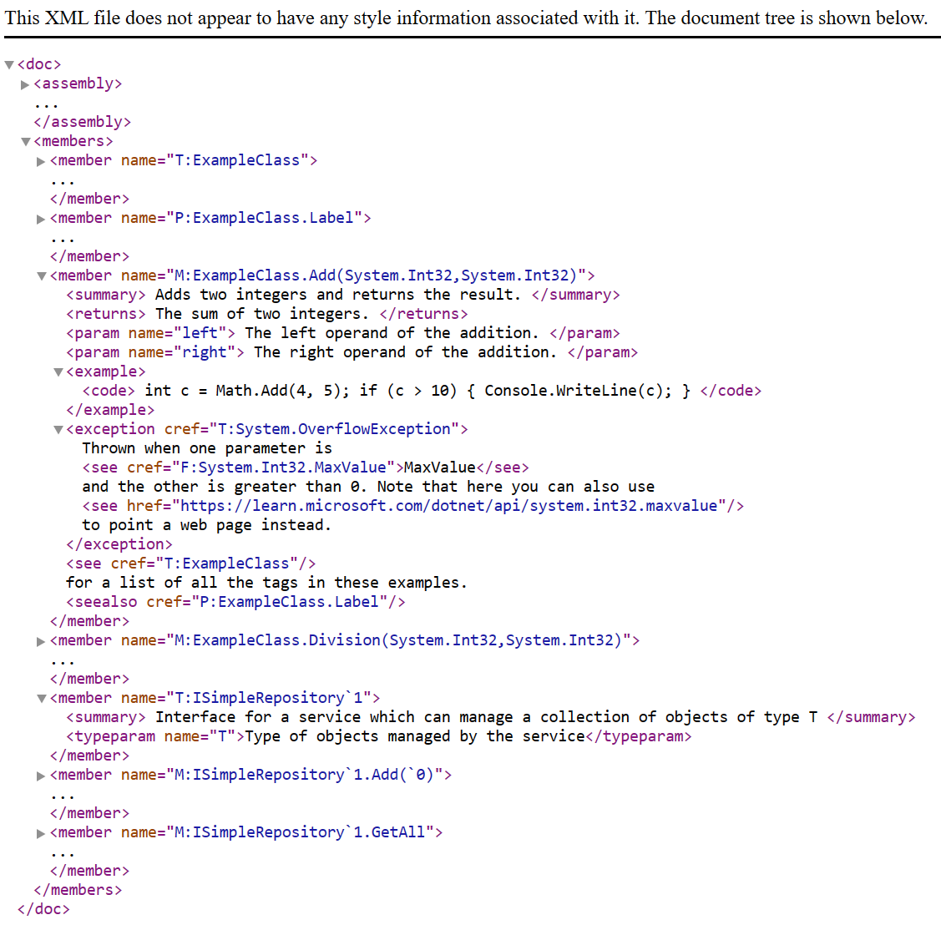

Slide 20

Generating documentation artefacts
I have an .xml file… so what…?
Can be used by various external tools for generating documentation artefacts
Sandcastle
GhostDoc
DocFX
Doxygen
…and probably others

Slide 21
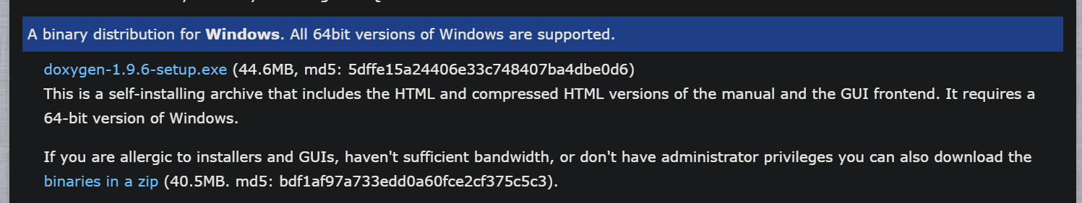
Generating documentation with Doxygen
NB: Not claiming Doxygen to be superior, only used as an example.
Free, go to: https://www.doxygen.nl/download.html
Download and install latest version (April 2023 -> v1.9.6)
NB: Does not require .xml file to be generated!

Slide 22
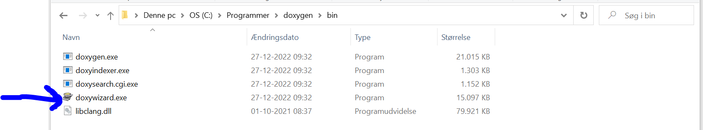

Slide 23
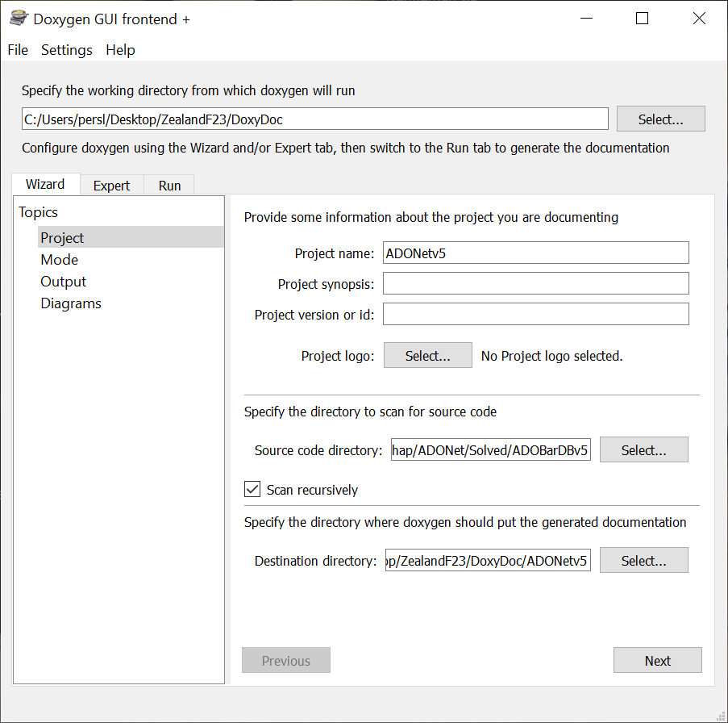
1
2
3
4
5

Slide 24
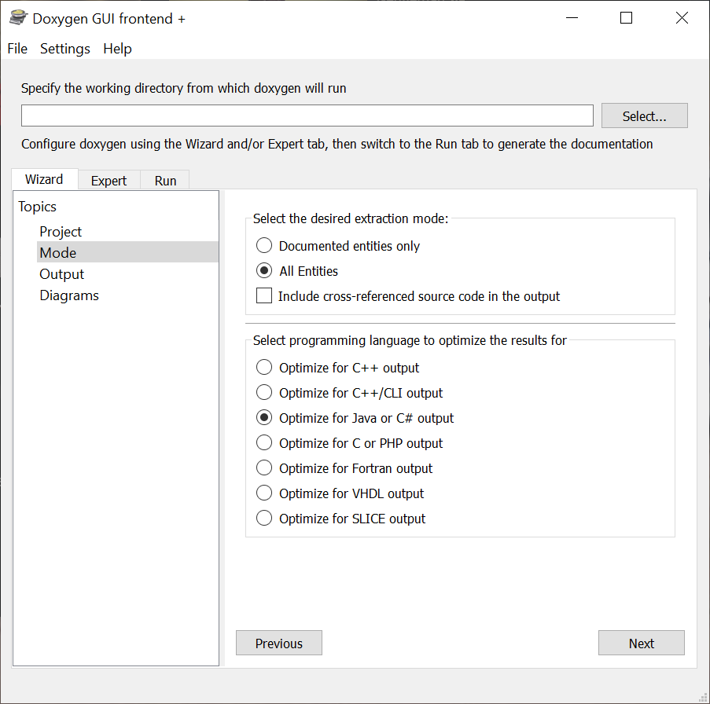
1
2
3

Slide 25
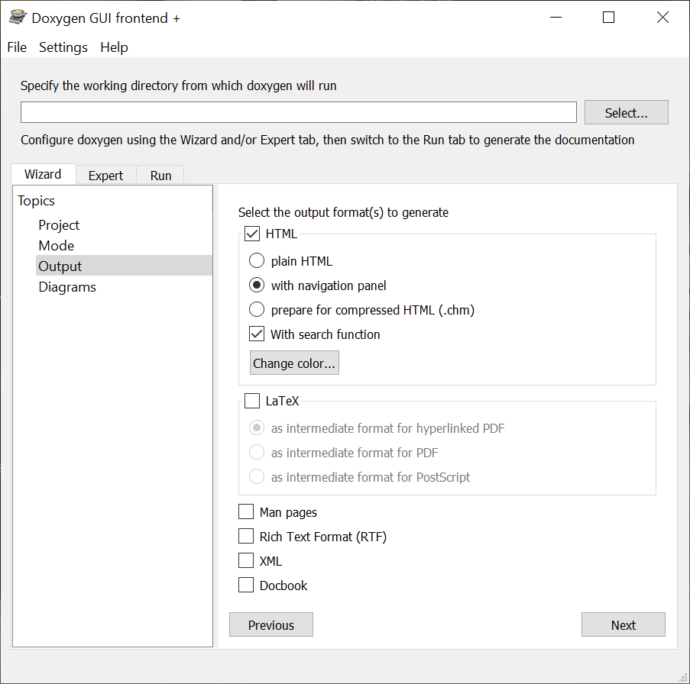
1
1a
2

Slide 26
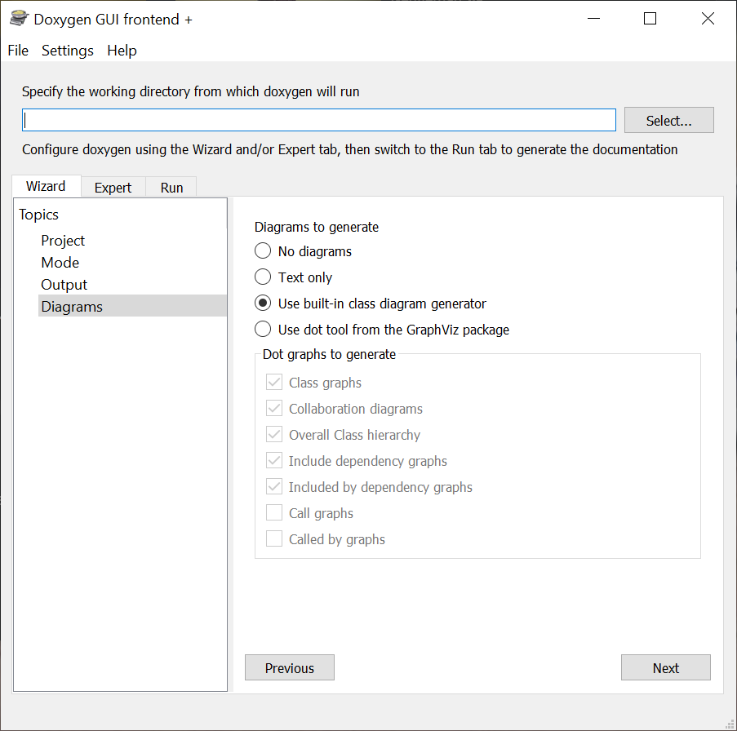
1
2

Slide 27
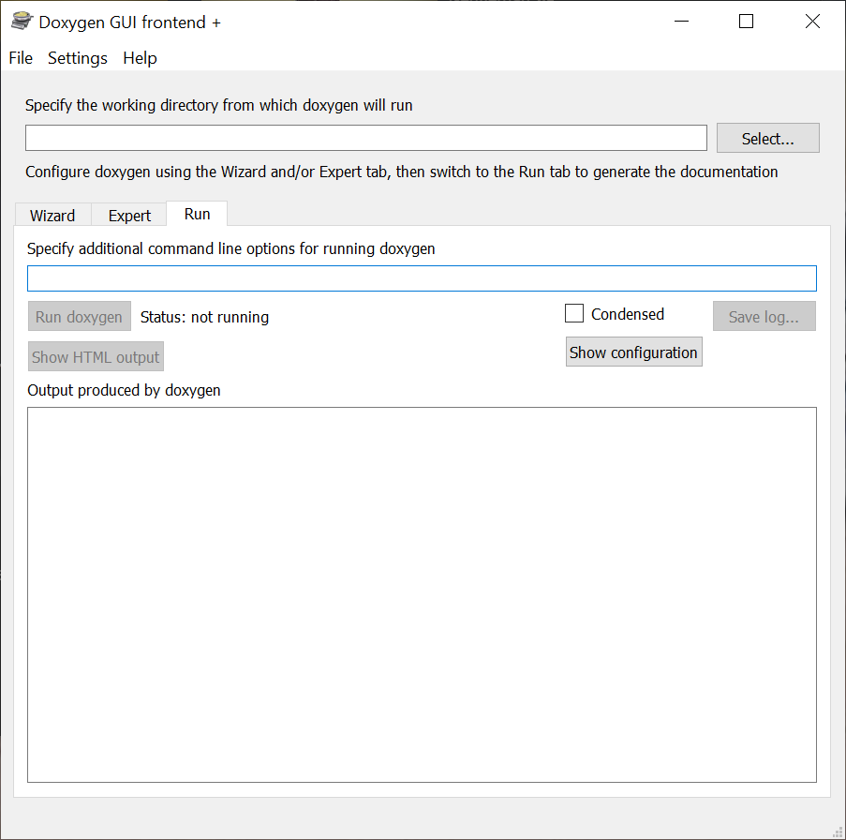
1
2

Slide 28
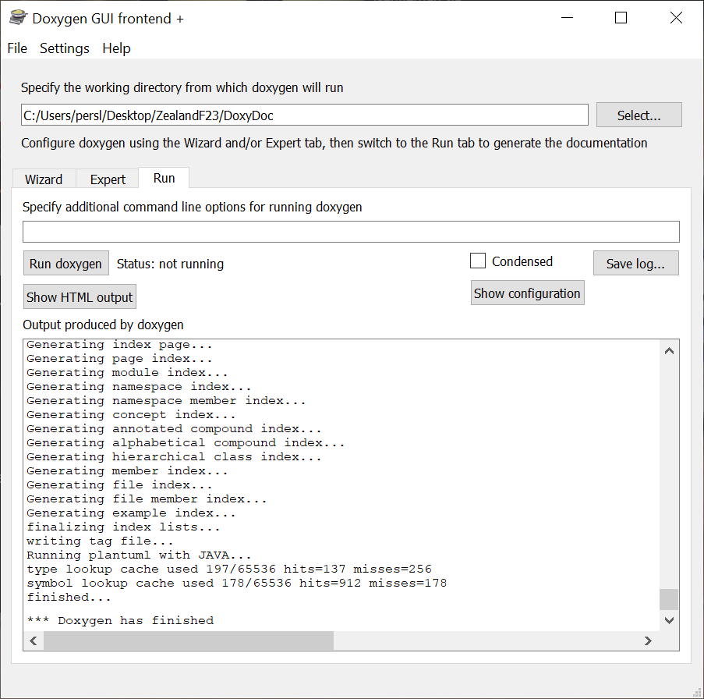

Slide 29
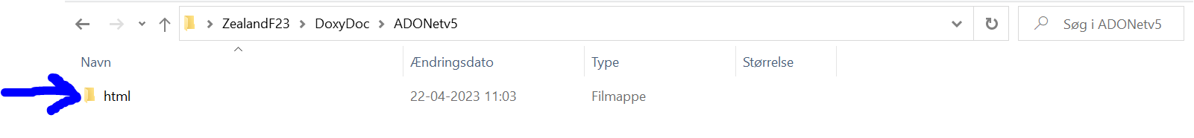
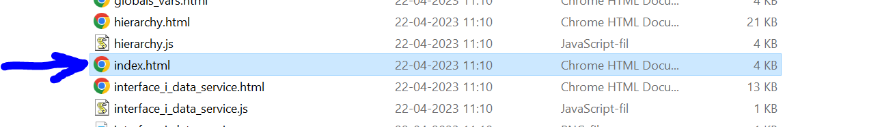

Slide 30
